Slide 1
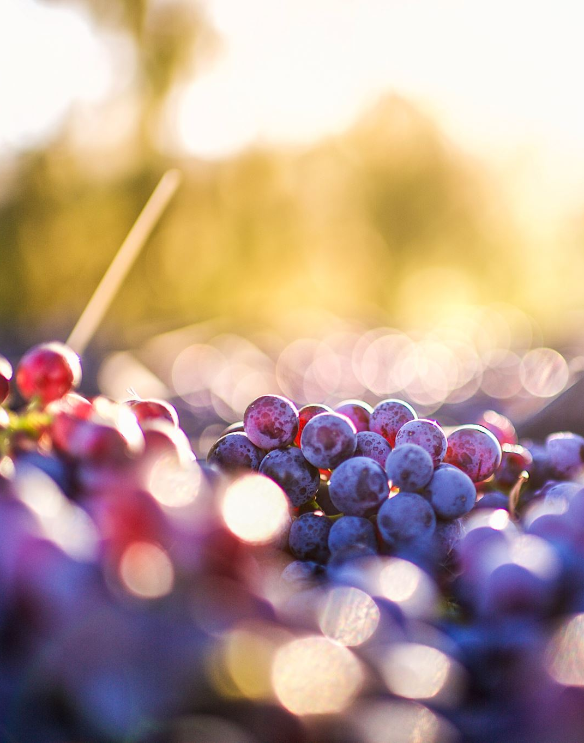
PREDICTION OF RED WINE QUALITY
Student: Thu Hue Duong
Date: 04/09/2023
Course: Data analyst FT OCT 2022

Slide 2
Agenda
1. Introduction
2. Material and method
2.1. Red wine quality dataset
2.2. Initial Assumptions and Hypotheses
2.3. Exploratory Data Analysis (EDA)
2.3.1. Variables analysis
2.3.2. Replacement of outliers with average
2.3.3. Correlation between variables
2.4. Building linear regression model
2.4.1. Running regression model
2.4.2. Comparison between quality and forecasted quality
3. Conclusion

Slide 3
1. Introduction
Export of its Vinho Verde wine grew by more than three million liters in 2021.
Identify trends and patterns and relationships between variables
Pouring a beverage
Enriching and memorable experience for customers
Benefit of serving wines in restaurants
Portugal wines
Purpose of the report
Understand the main characteristics of datasets, explore the variables.
Predict the final quality of Vinho Verde red wine to order large quantities of wine
In 2021, Portugal exported $1.1B in Wine - 9th largest exporter.
The main wine products of Vinho Verde are white, red and rose wines.
Suitable for a wide range of dishes
Promoting responsible consumption, profit

Slide 4
2. Material and method
2.1. Red wine quality dataset
Collected from May/2004 to February/2007 using only protected designation of origin samples.
Each entry denotes a given test (analytical or sensory).
Contains 1599 red wine examples
The wine quality is scaled from 0 (very bad) to 10 (excellent).
Most of the wine samples got quality scores of 5 and 6 (681 and 638 samples). 18 wines were evaluated 8 score
The quality is evaluated by at least three sensory assessors and gets the average score.

Slide 5
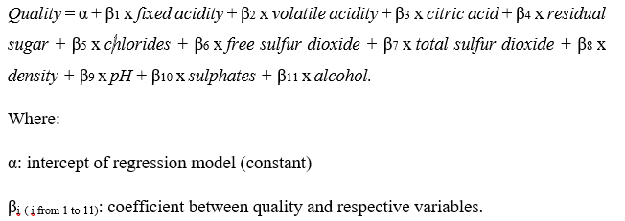
2. Material and method
2.2. Initial Assumptions and Hypotheses
 | Mean | Median | Mode | Standard Deviation | Skewness | Maximum | Minimum
fixed acidity | 8.32 | 7.90 | 7.20 | 1.74 | 0.98 | 15.90 | 4.60
volatile acidity | 0.53 | 0.52 | 0.60 | 0.18 | 0.67 | 1.58 | 0.12
citric acid | 0.27 | 0.26 | 0.00 | 0.19 | 0.32 | 1.00 | 0.00
residual sugar | 2.54 | 2.20 | 2.00 | 1.41 | 4.54 | 15.50 | 0.90
chlorides | 0.09 | 0.08 | 0.08 | 0.05 | 5.68 | 0.61 | 0.01
free sulfur dioxide | 15.88 | 14.00 | 6.00 | 10.46 | 1.25 | 72.00 | 1.00
total sulfur dioxide | 46.47 | 38.00 | 28.00 | 32.90 | 1.52 | 289.00 | 6.00
density | 1.00 | 1.00 | 1.00 | 0.00 | 0.07 | 1.00 | 0.99
pH | 3.31 | 3.31 | 3.30 | 0.15 | 0.19 | 4.01 | 2.74
sulphates | 0.66 | 0.62 | 0.60 | 0.17 | 2.43 | 2.00 | 0.33
alcohol | 10.42 | 10.20 | 9.50 | 1.07 | 0.86 | 14.90 | 8.40
Use descriptive statistics for summarizing the characteristics of numeric variables.
Correlation analysis presents the relationship between the quality variable and the remaining variables. Correlation analysis presents the relationship between the quality variable and the remaining variable
We build regression models and compare their adjusted R-squared value to get the best-fit model with the dataset.

Slide 6
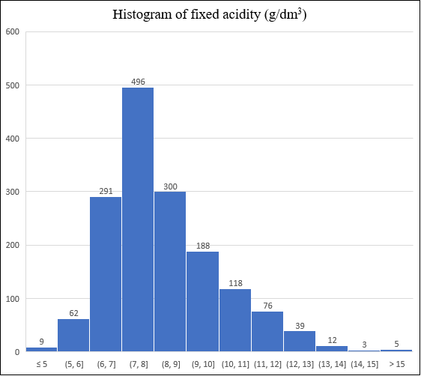
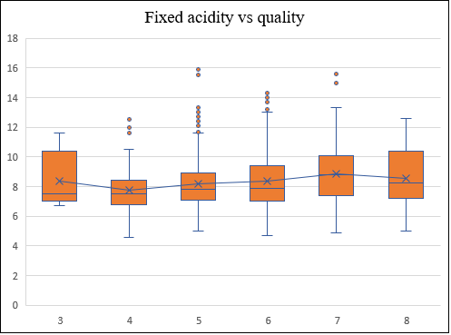
2. Material and method
2.3. Exploratory Data Analysis (EDA)
2.3.1. Variables analysis
Fixed acidity analysis
the most common level of fixed acidity in Vinho Verde red wine is between 7 g/dm³ and 8 g/dm³ (498 samples)
very few wines having a fixed acidity of less than 5 g/dm³ or greater than 14 g/dm³
an uncertain trend of fixed acidity levels based on the wine quality.
50% of red wine evaluated quality scores of 7 and 8 have fixed acidity from 7.2 g/dm³ to 10 g/dm^{3.}
in the range of 8.56 g/dm³ and 8.87 g/dm³

Slide 7
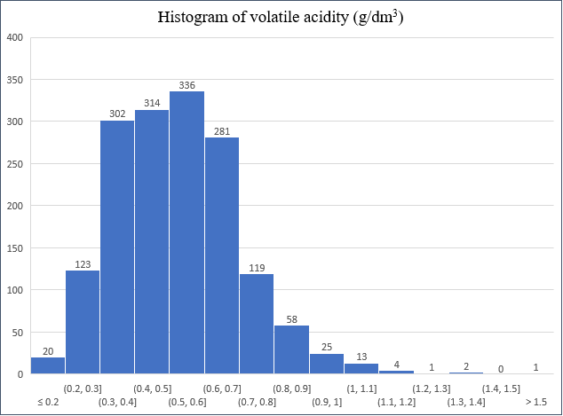
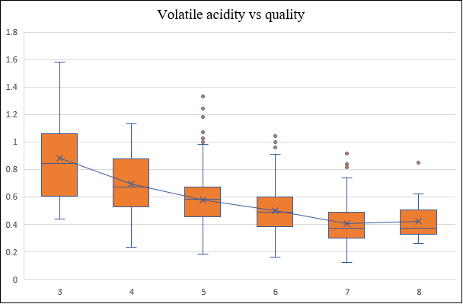
2. Material and method
2.3. Exploratory Data Analysis (EDA)
2.3.1. Variables analysis
Volatile acidity analysis
The high-quality wine contains a lower level of volatile acidity..
50% of wine with an 8 score of quality concentrates from 0.32 g/dm³ to 0.5 g/dm³ volatile acidity.
50% of wine with a 3 score of quality contains from 0.63 g/dm³ to 1.06 g/dm³ volatile acidity
=> higher the volatile acidity the wine gets, the lower the quality of the wine
The common volatile acidity in red wine is from 0.3 g/dm³ to 0.7 g/dm³ (1233 samples )
very few wines that have volatile acidity less than 0.2 g/dm³ or greater than 1 g/dm³

Slide 8
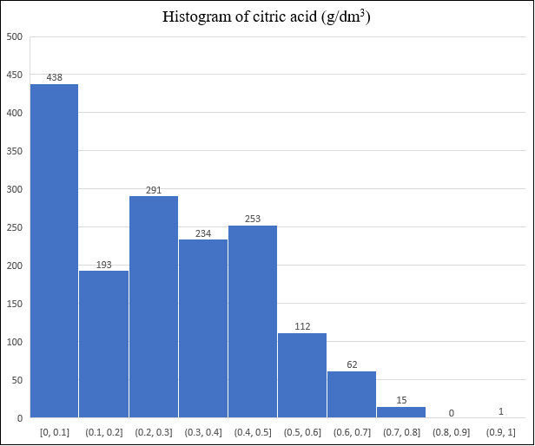
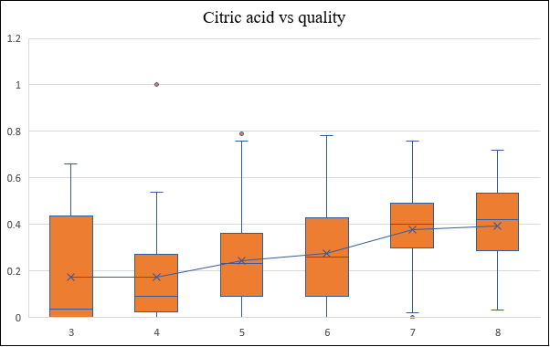
2. Material and method
2.3. Exploratory Data Analysis (EDA)
2.3.1. Variables analysis
Citric acid analysis
60% of red wine samples consist of less than 0.3 g/dm³ of citric acid.
only 5% of samples consist of more than 0.6 g/dm³ of citric acid.
=> winemakers usually add a small quantity of citric acid into wine
lower-quality wine concentrates a lower average level of citric acid.
higher-quality one concentrates a higher average level of citric acid.
50% of 7 and 8 scores of quality wine hold from 0.3 g/dm³ to 0.5 g/dm³ of citric acid and about 0.4 g/dm³ of citric acid on average

Slide 9
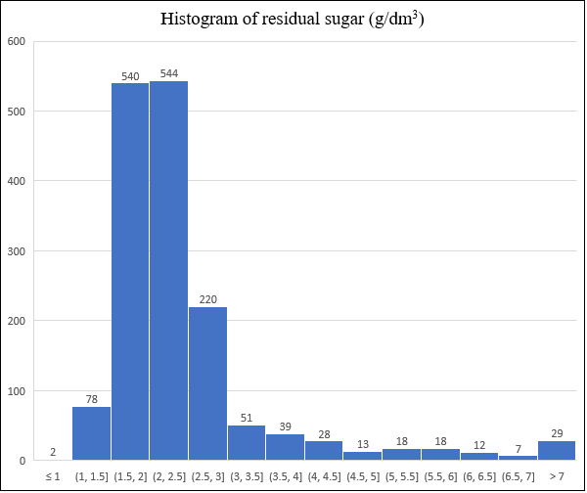
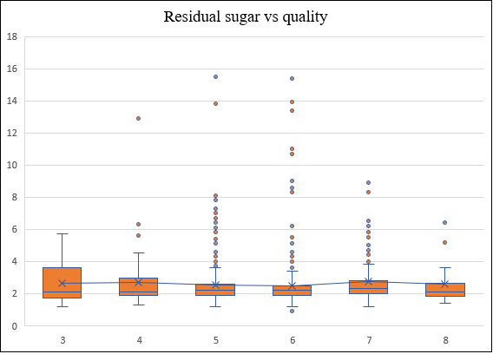
2. Material and method
2.3. Exploratory Data Analysis (EDA)
2.3.1. Variables analysis
Residual sugar analysis
no specific tendency of residual sugar based on the different wine qualities.
the range of residual sugar in 8-score quality wine is the narrowest, from 1.4 g/dm³ to 3.6 g/dm³.
Most Vinho Verde red wines include residual sugar in the range of 1.5 g/dm³ and 2.5 g/dm³.
1084 of 1599 samples.

Slide 10
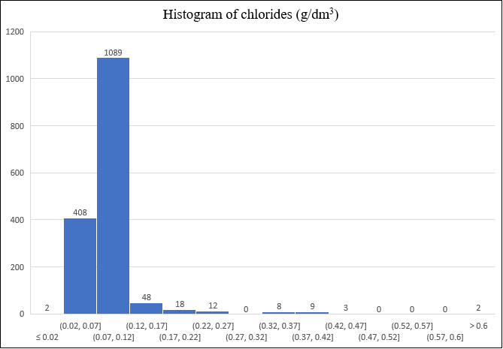
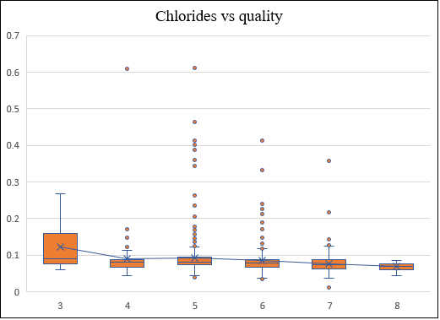
2. Material and method
2.3. Exploratory Data Analysis (EDA)
2.3.1. Variables analysis
Chlorides analysis
less amount of chlorides the wine contains, the higher quality the wine gets.
the amount of chlorides in 8-score quality wines is between 0.044 g/dm³ and 0.086 g/dm³.
involve from 0.02 g/dm³ to 0.12 g/dm³ chlorides.

Slide 11
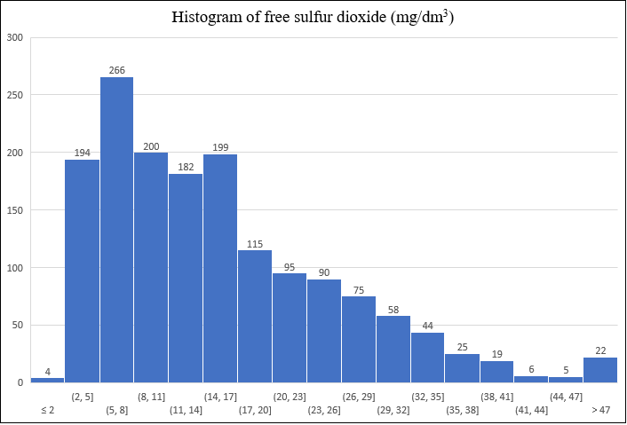
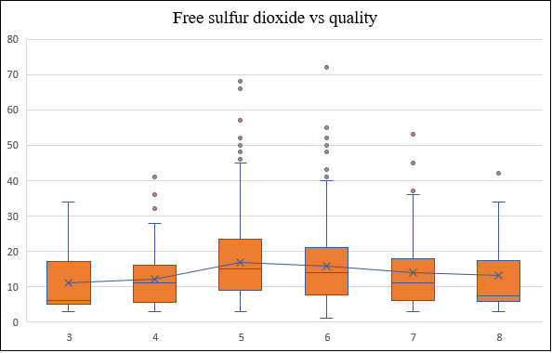
2. Material and method
2.3. Exploratory Data Analysis (EDA)
2.3.1. Variables analysis
Free sulfur dioxide analysis
varies from less than 2 mg/dm³ to more than 47 mg/dm³.
winemaker mostly add from 5 mg/dm³ to 8 mg/dm³ into red wine.
an insignificant difference in the amount of free sulfur dioxide in 8-score quality and other wines.
cannot define a co-movement between the amount of free sulfur dioxide and quality of wine

Slide 12
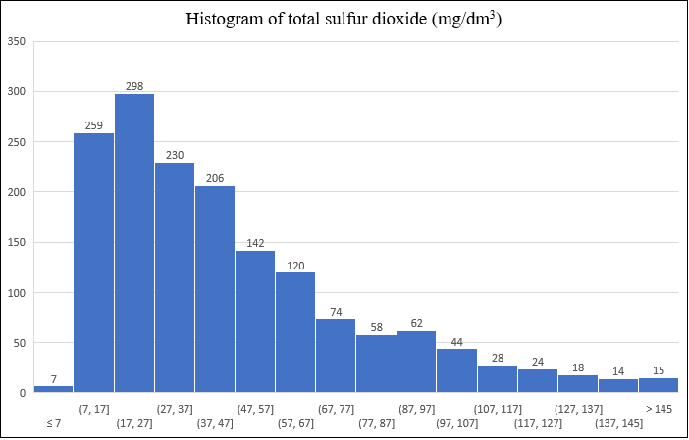
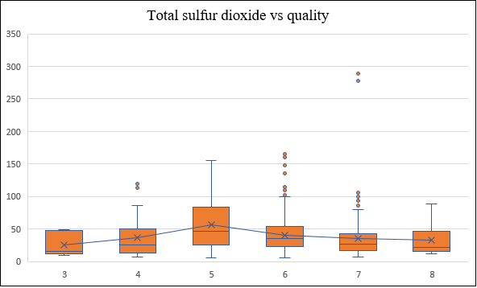
2. Material and method
2.3. Exploratory Data Analysis (EDA)
2.3.1. Variables analysis
Total sulfur dioxide analysis
always much lower than the maximum allowable concentration of free sulfur dioxide.
include 7 mg/dm3 to 67 mg/dm3
cannot define a co-movement between the amount of total sulfur dioxide and the quality of wine.
5-score quality wine seems to carry the highest levels of total sulfur dioxide

Slide 13
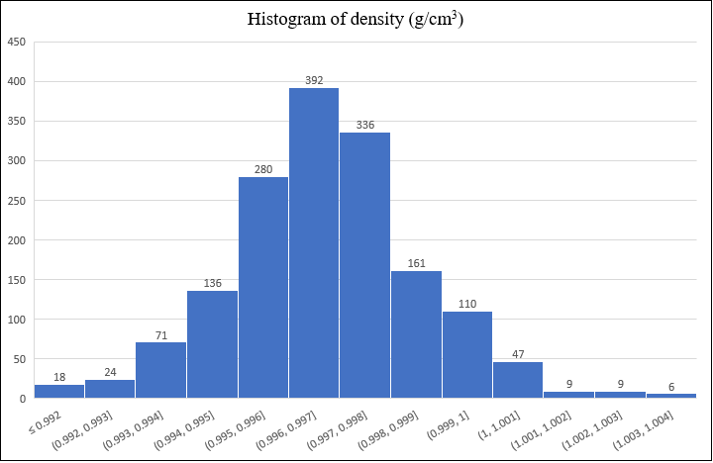
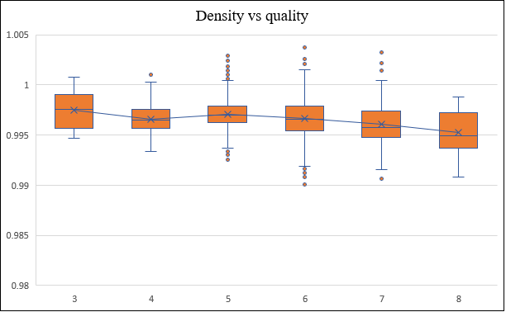
2. Material and method
2.3. Exploratory Data Analysis (EDA)
2.3.1. Variables analysis
Density analysis
a little distinction in density can change the wine quality.
the lower the density of wine, the higher the quality of the wine.
The average density of 8-score wines is 0.995
varies between 0.99 g/cm³ to 1 g/cm^{3.}
63% of red wine samples have a density of from 0.995 g/cm³ to 0.998 g/cm³

Slide 14
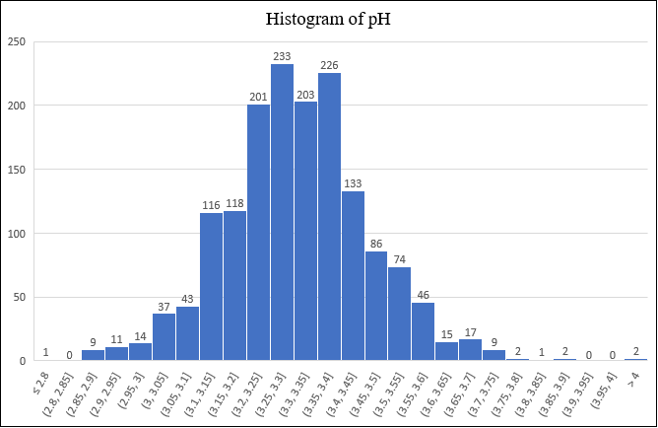
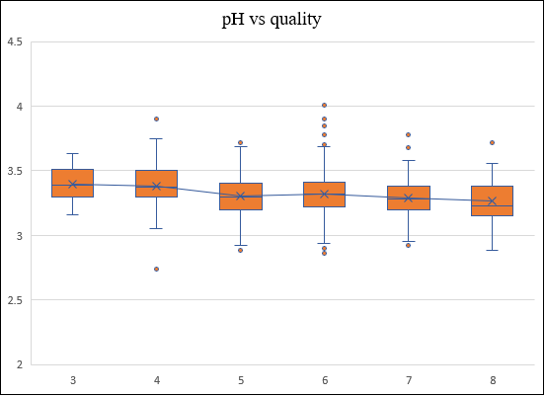
2. Material and method
2.3. Exploratory Data Analysis (EDA)
2.3.1. Variables analysis
pH analysis
54% of Vinho Verde red wines have a pH from 3.2 to 3.4.
samples with pH less than 3 and more than 3.6 accounts for 2.2% and 3% of 1599 samples
the pH of wines experiences a downward trend between 3.4 and 3.27 from 3-score to 8-score quality wines.
=> the lower the pH in wine, the higher the wine quality

Slide 15
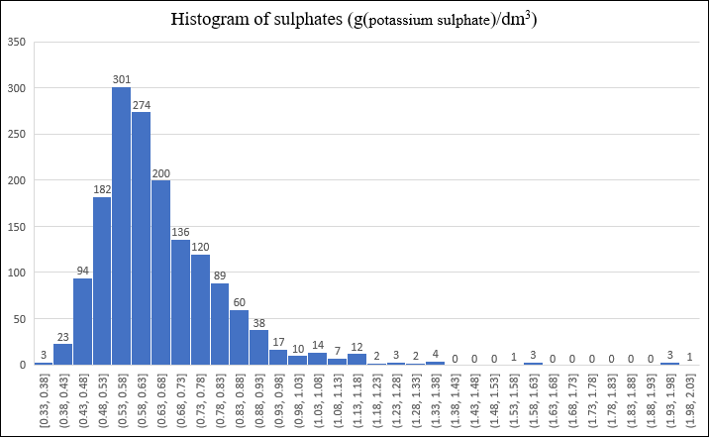
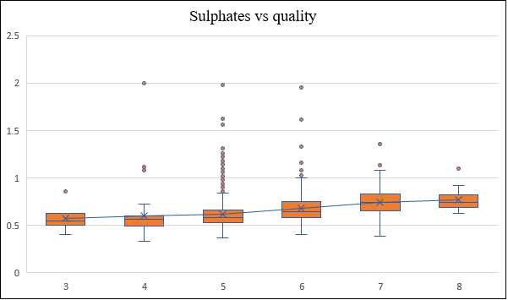
2. Material and method
2.3. Exploratory Data Analysis (EDA)
2.3.1. Variables analysis
Sulphates analysis
Most winemakers control from 0.48 g/dm3 to 0.83 g/dm3 (75.86% wine samples ).
301 samples concentrating between 0.53 g/dm3 and 0.58 g/dm3 of sulfates
the higher sulfates the wines contain, the higher quality the wines have.
8-score quality wines include the highest average amount of sulfates

Slide 16
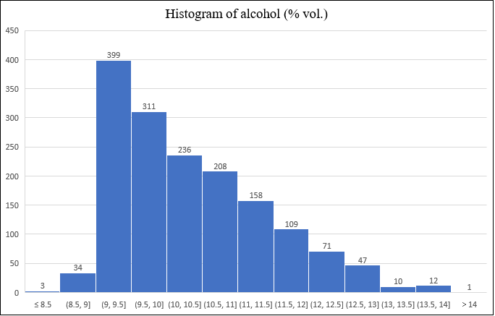
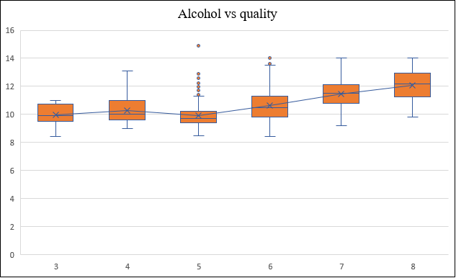
2. Material and method
2.3. Exploratory Data Analysis (EDA)
2.3.1. Variables analysis
Alcohol analysis
the most common alcohol volume: between 9% and 9.5% vol (399 wine samples).
88.87 % of Vinho Verde red wine holds from 9% to 12% alcohol
8-score quality wines include the highest alcohol volume at 12.09 % vol on average.
increase in the alcohol volume can lead to a rise in wine quality

Slide 17
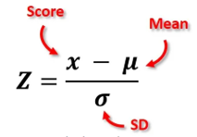

2. Material and method
2.3. Exploratory Data Analysis (EDA)
2.3.2. Replacement of outliers with average
by using z-score
residual sugar
chlorides
upper and lower thresholds
identify outliers and replace them with the mean values
heavily skewness
free sulfur dioxide
smaller than the lower threshold or greater than the upper threshold
=> replaced with the average
total sulfur dioxide
sulphates
 | Residual sugar | chlorides | free sulfur dioxide | total sulfur dioxide | sulphates
Mean | 2.54 | 0.09 | 15.87555 | 46.46842 | 0.658149
Standard Deviation | 1.409928 | 0.047065 | 10.46043 | 32.89592 | 0.169507
Low | -1.69098 | -0.05373 | -15.5058 | -52.2193 | 0.149628
high | 6.76859 | 0.228662 | 47.25685 | 145.1562 | 1.16667

Slide 18
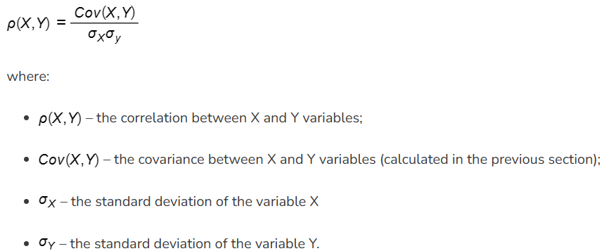
2. Material and method
2.3. Exploratory Data Analysis (EDA)
2.3.3. Correlation between variables
statistical measure of the relationship between two variables
the relationship between quality variables and the remaining variable in the dataset
Correlation | Quality | Absolute value
fixed acidity | 0.124051649 | 0.124051649
volatile acidity | -0.39055778 | 0.39055778
citric acid | 0.226372514 | 0.226372514
residual sugar | 0.033700461 | 0.033700461
chlorides | -0.148775172 | 0.148775172
free sulfur dioxide | -0.046599743 | 0.046599743
total sulfur dioxide | -0.20617765 | 0.20617765
density | -0.174919228 | 0.174919228
pH | -0.057731391 | 0.057731391
sulphates | 0.354152027 | 0.354152027
alcohol | 0.476166324 | 0.476166324
quality | 1 | 1

Slide 19
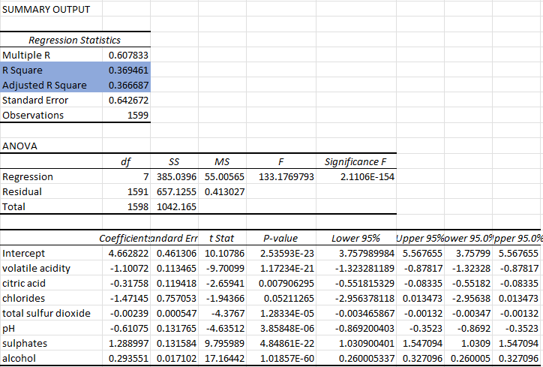
2. Material and method
2.4. Building linear regression model
2.4.1. Running regression model
Quality = 4.66 – 1.1*volatile acidity – 0.32*citric acid – 1.47*chlorides – 0.0024*total sulfur dioxide – 0.61*pH + 1.29*sulphates + 0.29*alcohol.
The model and all variables are statistically significant (P-value <= 0.05).
the variance of explanatory variables can explain 36.95% of the variance of quality variables.
alcohol and sulphates have positive relationships with Vinho Verde red wine quality.
negative relationships between red wine quality and volatile acidity, citric acid, chlorides, total sulfur dioxide, and pH.

Slide 20
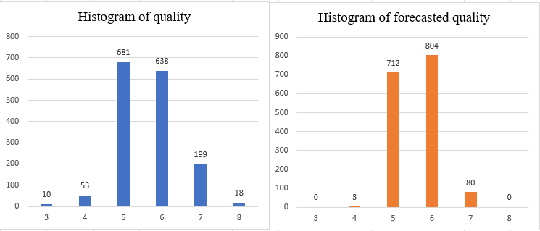
2. Material and method
2.4. Building linear regression model
2.4.2. Comparison between quality and forecasted quality
Quality | % of accuracy
3 | 0.00%
4 | 1.89%
5 | 70.34%
6 | 67.08%
7 | 22.61%
8 | 0.00%
Total | 59.60%
59.6% of red wines are predicted accurate quality
0% of 3 and 8 wine quality is predicted accurate.
forecast precisely 67.08% and 70.34% of 5 and 6-score quality wine, respectively.
big difference between forecasted quality and reality quality
the numbers of 5 and 6-score quality wines are higher than in reality.
no 3 and 8-score quality wines in forecasted quality.

Slide 21
3. Conclusion
- quality certification of red wine is a crucial step to improve customer satisfaction and profitability of restaurants.
- investigated 1599 Vinho Verde red wine samples.
- Wine quality is scaled from 0 to 10
- The high importance of chloride ranks first, followed by that of sulphates.
- alcohol level is less important.
- reduce the level of volatile acidity, citric acid, chlorides, total sulfur dioxide, and pH and increase that of sulphates and alcohol, the wine quality will be improved
- the regression model can predict exactly the wine quality of 953 samples in 1599 red wine samples
- high risk when restaurant managers use this model to forecast wine quality and based on that order a large amount of red wine.
- proceed with the training model or can experiment with other algorithms.

Slide 22
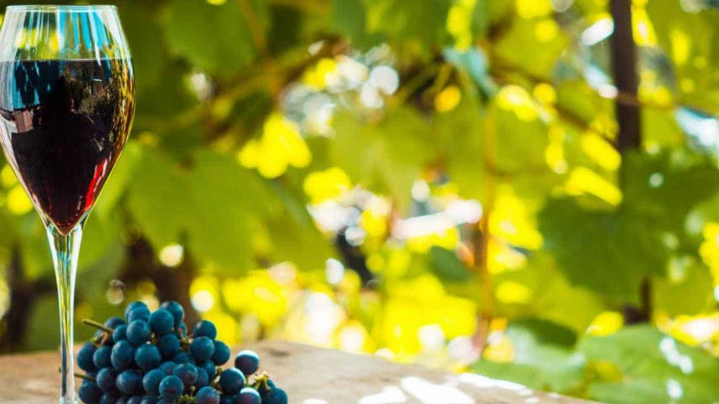
THE END
Thank you for your attention

